Slide 1
Week1
Self-Attention & Transformer

Slide 2








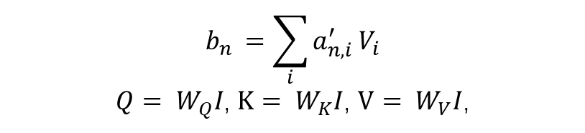














Self-Attention
$$b_{n }=\sum_{i}^{ }{a_{n,i}^{′}}V_{i}$$
$Q= W_{Q}I$, $K= W_{K}I$, $V= W_{V}I$,
$$b_{1}$$
$$a_{1,1}^{′}$$
$$×$$
$$a_{1,2}^{′}$$
$$×$$
$$a_{1,3}^{′}$$
$$×$$
Softmax
$$a_{1,1}$$
$$a_{1,2}$$
$$a_{1,3}$$
$$Q_{1}$$
$$K_{1}$$
$$V_{1}$$
$$Q_{2}$$
$$K_{2}$$
$$V_{2}$$
$$Q_{3}$$
$$K_{3}$$
$$V_{3}$$
$$I_{1}$$
$$I_{2}$$
$$I_{3}$$
Notes:
图中示例为i1的注意力计算, 其中Q, K, V为i乘上不同的权重矩阵Wq, Wk, Wv得到. 接着让Q1分别与K1, K2, K3相乘, 得到a11, a12, a13, 再经过Softmax处理得到a’11, a’12, a’13. 最后将所有的a’与对应的V相乘再相加得到最终的输出b1

Slide 3
























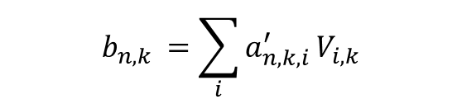








Multi-Head Attention
$$b_{n,k }=\sum_{i}^{ }{a_{n,k,i}^{′}}V_{i,k}$$
$$a_{1,1,1}^{′}$$
$$a_{1,2,1}^{′}$$
$$a_{1,1,2}^{′}$$
$$a_{1,2,1}^{′}$$
$$b_{1,1}$$
Softmax
$$b_{1}$$
$$W$$
$$b_{1,2}$$
$$a_{1,1,1}$$
$$a_{1,2,1}$$
$$a_{1,1,2}$$
$$a_{1,2,1}$$
$$Q_{1,1}$$
$$Q_{1,2}$$
$$K_{1,1}$$
$$K_{1,2}$$
$$V_{1,1}$$
$$V_{1,2}$$
$$Q_{2,1}$$
$$Q_{2,2}$$
$$K_{2,1}$$
$$K_{2,2}$$
$$V_{2,1}$$
$$V_{2,2}$$
$$Q_{1}$$
$$K_{1}$$
$$V_{1}$$
$$Q_{2}$$
$$K_{2}$$
$$V_{2}$$
$$I_{1}$$
$$I_{2}$$
Notes:
Multi-Head Attention与前者类似, 但有多个Q, K, V, 为原来的Q, K, V再乘上不同的权重矩阵得到. 之后的计算与前者相同, 但有多个b. 得到b后将其拼接起来再乘上一个权重矩阵, 得到 最后的输出b’

Slide 4
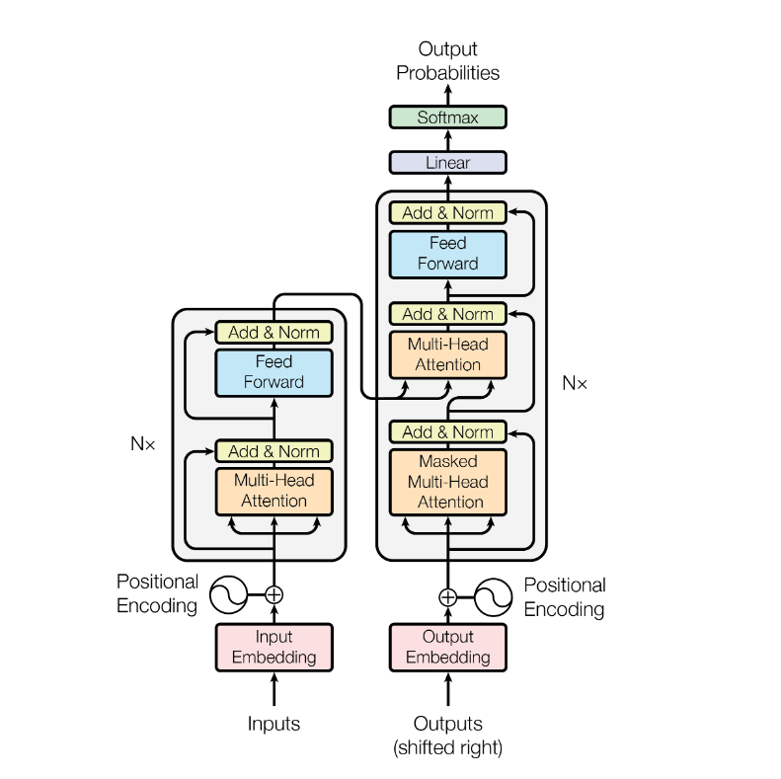
Transformer
Encoder Layer
Decoder Layer
Transformer Architecture

Slide 5
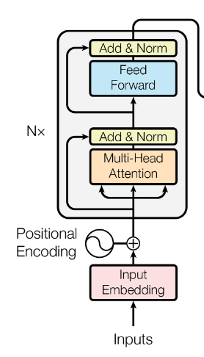
Encoder Layer
Encoder Stack made up of two layers: Multi-Head Attention layer & Feed Forward layer.
Each layer has a residual connection and a LayerNorm layer
Encoder consist of same Encoder Layer

Slide 6






Encoder Layer
Layer1: Multi-Head Attention Layer
Layer2: Feed Forward Layer
$$b$$
$$o$$
LayerNorm
LayerNorm
$$+$$
$$+$$
Residual Module
Residual Module
Linear
Multi-head attn
ReLU
Feed forward
Q
K
V
Linear
$$I$$
$$b$$
Notes:
图中仅为单个输入向量, 实际中有多个输入i1…in, 其输出向量个数与输入相同, 即输出为O1…On.

Slide 7










Encoder Layer
Transformer
RNN
$$b_{1}$$
$$b_{2}$$
$$b_{3}$$
$$b$$
Encoder
Encoder
$$I_{1}$$
$$I_{2}$$
$$I_{3}$$
$$I_{1}$$
$$I_{2}$$
$$I_{3}$$
The output of Encoder module is different between Transformer and RNN.
Notes:
可见Transformer的Encoder输出格式与RNN不同, RNN中Encoder的不足在于: 无论有多少输入, 最后只会输出长度固定的Tensor, 在输入Tensor长度较长的情况下, 会损失信息.

Slide 8
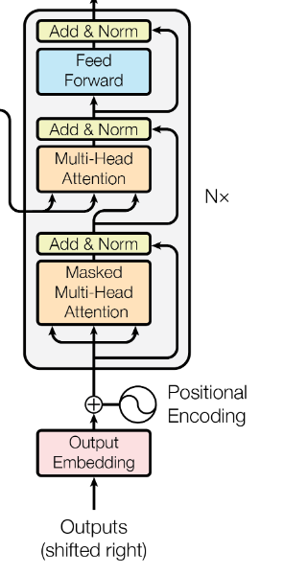
Decoder Layer
Decoder Stack made up of three layers: Multi-Head Attention layer , Masked Multi-Head Attention layer & Feed Forward layer.
Each layer has a residual connection and a LayerNorm layer
Decoder consist of same Decoder Layer

Slide 9








Decoder Layer
Layer2: Multi-Head Attention Layer
Layer3: Feed Forward Layer
$$b_{1}$$
Q
$$b_{2}$$
$$o$$
LayerNorm
LayerNorm
LayerNorm
$$+$$
Residual Module
$$+$$
$$+$$
Residual Module
Linear
Masked Multi-head attn
Multi-head attn
V
ReLU
Feed forward
Q
K
V
Encoder
output
Linear
$$I$$
K
$$b_{2}$$
Layer1: Masked Multi-Head Attention Layer
Notes:
图中同样仅为输入只有一个向量的情况. Layer2的输入来自Layer1和Encoder, 其中Layer1提供Q, Encoder提供K和V.

Slide 10
Transformer Architecture
Attn & FFN
Mask Multi-Head Attn
Decoder stack
K,V
Attn & FFN
Q
Decoder layer
Encoder layer
Mask Multi-Head Attn
Encoder stack
Encoder layer
Encoder layer

